Slide 1
OMSC AGM
Sunday, November 5th, 2017

Slide 2
Agenda
Welcome & Introductions
Adoption of Agenda
Approval of 2016 AGM minutes
Reports
Election of Directors
Short Break
Awards

Slide 3
Welcome & Introductions
2016/2017 Directors
Acting President: Sharon Spring
Vice President: Carmelle Guidi-Swan
Secretary: Laura Fleming
Treasurer: Brenda Balderson
Registrar: Cailla Patterson
Meet Manager: Norma Lachance
Communications Director: Gord Sparrey
At-Large: Greg Harris
At-Large: Carol Taylor

Slide 4
Welcome & Introductions
2016-17 Coaches:
Rohan Jacobs
Thomas Robinson
Christina Russo
Jon Smirl
Pascal Sutherland
Sally Wallick
2017-18 Coaches:
We additionally welcome:
Stefan Pripoae
Samantta Villanueva
David Dimitrov

Slide 5
Reports
President
Treasurer
Meet Manager
Communications Director
Coaching

Slide 6
President’s Report
A year of consolidating our financial position and taking on the MSABC Provincials - our 2016-17 priorities were to:
Increase our membership to 120 average while enhancing the swim experience:
Actual membership increase - 125 average
Added 6:45am session for Tues/Thurs and watched lane utilization closely
Coaching Team worked well without a Head Coach - spread the jobs around
Communications to members was effective with increased engagement

Slide 7
President’s Report
Run a successful provincials:
Attendance was 190 swimmers
Excellent, smooth meet; fun evening event
Great line-up of sponsors - dollars and in-kind prizes
Update Bylaws and Policy
Compliance with BC Society Act
OMSC/YMCA Contract updated
Financial Reserves statement
Look at Open Water events
Too much on top of tackling Provincials - next year

Slide 8
President’s Report
Priorities for 2017/18:
1. Proactively manage our membership to maintain sufficient numbers to be able to offer a wide variety of swim sessions and coaching while continually looking for ways to better the swim experience.
2. Engage our membership in a discussion about a possible name change.
3. Continue to update our Bylaws and Policies.
4. Look at Open Water events to assess whether OMSC should be involved.

Slide 9
President’s Report
Special Initiatives Funding:
Budget broken into three sections last year - Program Costs (Y funded), Operating Costs ($30 funds this), and Special Initiatives (Financial Reserves)
Special Initiatives are considered investments in the club. The funds have come primarily from surpluses (profits) at our successful swim meets including 2017 Provincials.
We have made very few investments in the past 2 years as we stabilized our Program and Operating budgets.

Slide 10
President’s Report
Special Initiatives Funding for 2017-18:
Coaches at Swim meets - send a coach to meets to guide success
Coach Training - starting to invest again. Split all training costs with KAJ.
KAJ Scholarship Fund - donation, thanks for their volunteers at Provincials and Emil’s 2017-18 Training Plan, invest in our young swimmers.
Equipment - will not spend if we don’t need it.
Name change - will not spend if we decide not to change our name.

Slide 11
President’s Report
Why would OMSC look at a name change?
Better communicate where we are from
Kelowna has more “brand awareness” than Okanagan
“Okanagan” overlaps with other teams in the valley
We do not currently offer any pan-Okanagan swimming opportunities
Support Kelowna city and sport community by using the name
A name change would need a general membership approval

Slide 12
President’s Report
Review of YMCA funding model:
120 members
$77 each per month average - adult/senior/young adult
$111,000 of annual revenue
Coaching and lanes fees - $73, 000
Other Program Costs such as Clinics, Coach Premiums - $7,700
Balance goes to fund our Y membership - $29,000 / 120 = $20 per member

Slide 13
Treasurer’s Report

Slide 14
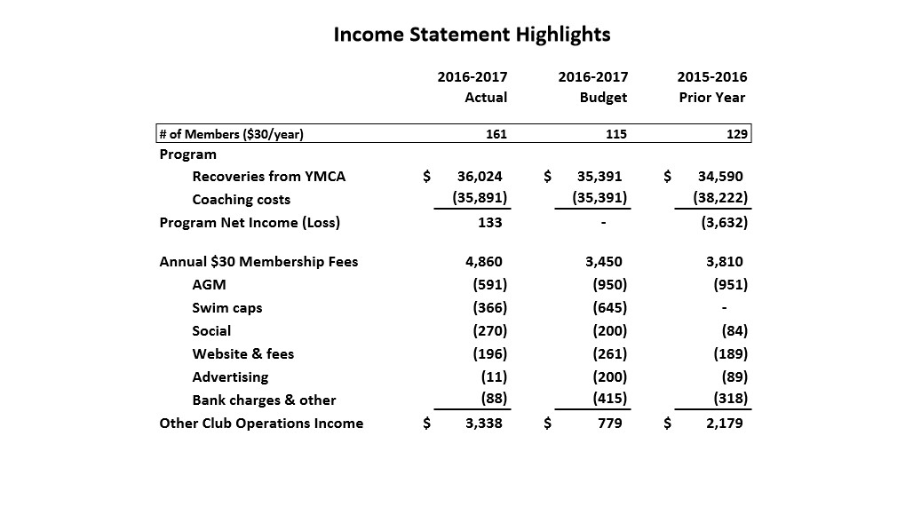

Slide 16
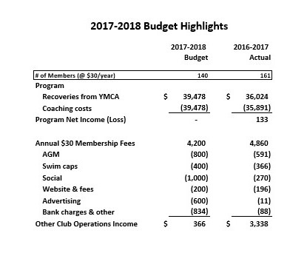

Slide 17
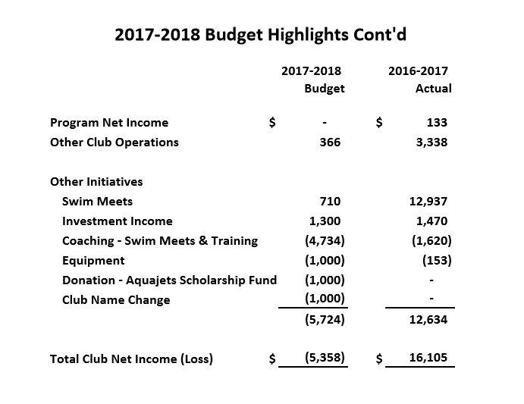

Slide 18
Meet Manager’s Report
Fright Fest
Officials Training
Provincials 2017 – Norma Lachance, Carmelle Guidi-Swan, Greg Harris, Cailla Patterson, Curtis Schreiber, Sandra Hobbs, Judy Flamank, Jennifer Leach-Trask
Quantum Timing System

Slide 19
Communications Director Report
Newsletter interaction with members:
Sent 71 email messages last season
Primary communication channel for pool closures, social activities, events, etc.
Members have access to past newsletters
We have 230 active subscribers up from 192 in 2016
Facebook interaction with members:
Thank you to our Facebook contributors
OMSC Chat Room (closed group) has 77 members, up from 41 last season
Our Okmasters Facebook main page has 313 page likes (followers)
Facebook ad campaign for our Open House reached 1051 targeted people at the cost of $15 US

Slide 20
Communication Director’s Report
Website: www.okmasters.com is a source for more detailed club information
Website updated with the great help of Gareth Eckley
Practice & clinic schedule
Events calendar – workouts, clinics, special events
Registration information
Contact information
New technique videos added during the season
We do not handle secure financial transactions on our website and rely on Clubassistant.com for Fright Fest

Slide 21
Communication Director’s Report
2017/2018 Plan:
Continue to use MailChimp for weekly club communications and announcements
Ensure all social events/stroke technique clinics and relevant information reaches our membership
Continue to respond to inquiries big and small which are received through communications@okmasters.com

Slide 22
Coaches’ Report
Coach Liaison Report
Successful Fright Fest, provincials and two members attended Worlds
Large number of swimmers in ATLS & Rattlesnake
Club is continuing to grow – retaining warmth and connectedness
Coaching “team approach” this year (similar to last year)
Change of coaching staff
Clinic plan for 2017-18 – increasing the mock meets

Slide 23
Election of Directors
Vice President
Communications Director
Secretary
Meet Manager
Director At Large

Slide 24
Break

Slide 25
Awards
Most Improved Female / Most Improved Male
Volunteer of the Year
Community Volunteer of the Year
Most Inspirational Swimmer
Swimmer of the Year
Elena Dimitrov Award
Novelty Awards and Club Thank Yous

Slide 26
Thank You.

