Slide 1
OMSC AGM
Sunday, November 4th, 2018

Slide 2
Agenda
Welcome & Introductions
Adoption of Agenda
Approval of 2017 AGM minutes
Reports
Short Break
Special Business
Election of Directors
Awards & Appreciation

Slide 3
Introductions
2017/2018 Directors
President: Sharon Spring
Vice President: Greg Harris
Secretary: Patrice Bazzana
Treasurer: Brenda Balderson
Registrar: Cailla Patterson
Meet Manager: Norma Lachance
Communications Director: Sandra Ballan-Brown
Social/Volunteer: Debra Parker
Coach Liaison: Carol Taylor

Slide 4
Introductions
2017-18 Coaches:
Roxana Chavez
Kassidie Cornell (summer)
Emily Epp
Rohan Jacobs
Stefan Pripoae
Thomas Robinson
Christina Russo
Sally Wallick
Samantta Villanueva

Slide 5
Approval of 2017 AGM Minutes

Slide 6
Reports
President
Treasurer
Meet Manager
Communications Director
Coach Liaison

Slide 7
President’s Report
Our 2017-18 Priorities were to:
Proactively manage our membership to maintain sufficient numbers to be able to offer a wide variety of swim sessions and coaching while continually looking for ways to better the swim experience.
Our membership grew to an average of 138 over the fall-winter months and @ 137 now
Required pro-actively managing peak sessions – closed 5:45 T/TH, added 11:30 M/W
Swim Clinics – popular but could they be expanded?
Social events were well attended – new Social committee for next year

Slide 8
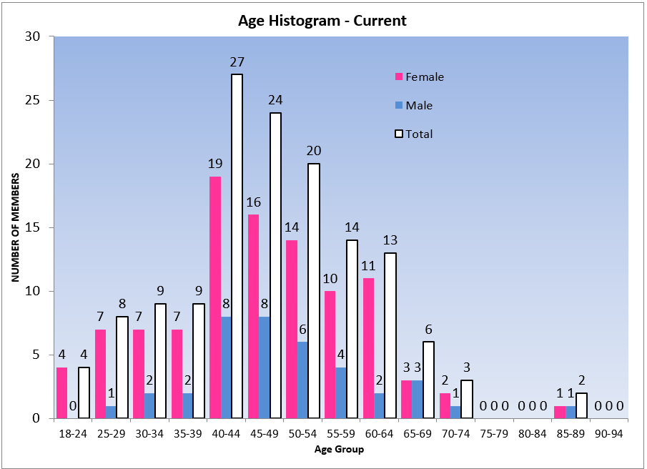

Slide 9
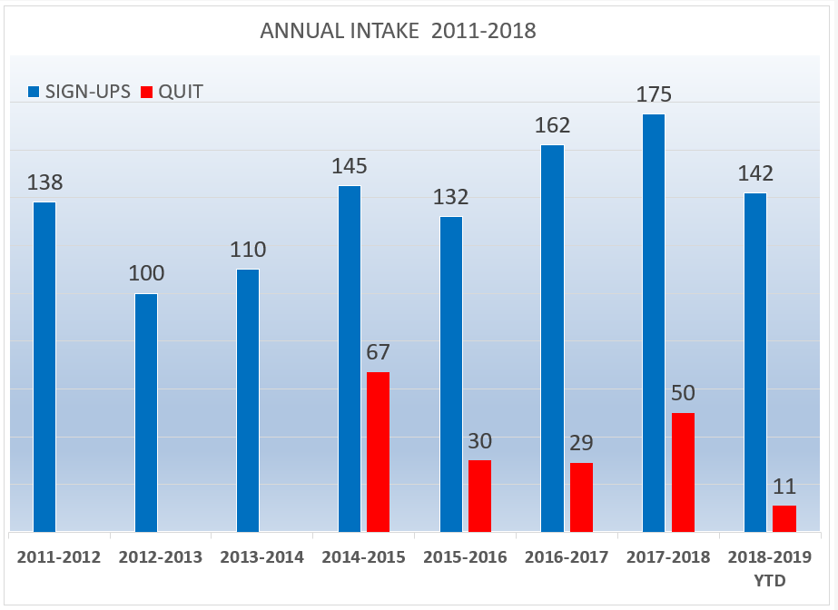

Slide 10
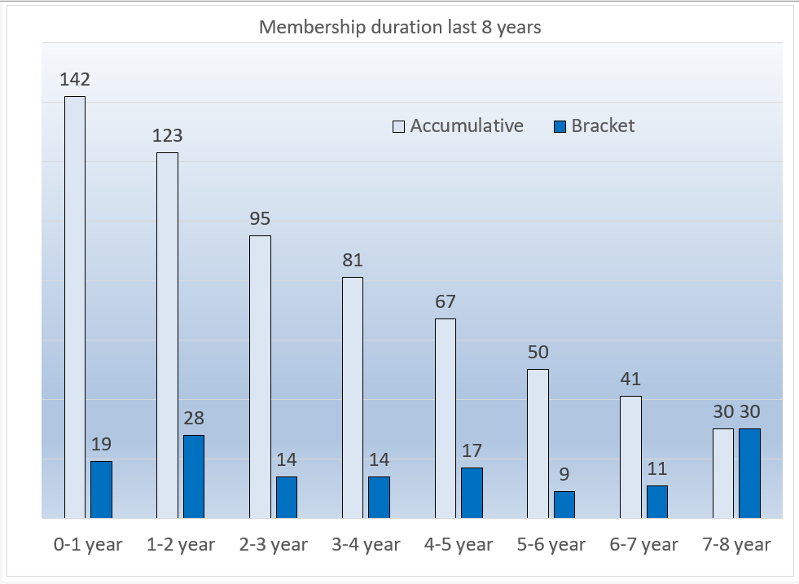

Slide 11
President’s Report
Proactively manage the Coaching Team to ensure that OMSC swimmers have a strong Coaching Program:
Annual Swim Plan that ensures all coaches are gearing their workouts to the same objectives,
Ensure that there are enough Coaches to manage all the practice times for OMSC and allow swimmers to experience different coaches and coaching styles by going to different practices,
Offer technique improvement opportunities outside of the regular workouts – M/W mid-day, M evening and Stroke Technique Clinics monthly,
Make partial funding available to OMSC Coaches for training and advancement.

Slide 12
President’s Report
3. Engage our membership in a discussion about a possible name change
After initial exploration from the Board, it was decided not to pursue this initiative.
4. Continue to update our Bylaws and Policies.
Many OMSC Policies were reviewed and updated this year – thank you to all the Board Members who researched, presented and updated our policies. New this year are the Social Media policy and Finance Guidelines policy.
Revised Bylaws will be presented later in the meeting for consideration.

Slide 13
President’s Report
5. Look at Open Water events to assess whether OMSC should be involved
OMSC is very supportive of the ATLS society and, of course, many OMSC members are also volunteers for and swim in their events - we will continue the strong alliance,
OMSC was supportive of the swim portion of the Apple Triathlon this summer - Brent Hobbs lead the gathering OMSC volunteers,
At this point, we do not see a role for OMSC in creating a separate Open Water event as the summer calendar is quite full already,
OMSC also has agreed to run the swim meet as part of the 55+ Games to be held in Kelowna in September, 2019.

Slide 14
President’s Report
What does 2018-19 look like?
Proactively manage our membership to maintain sufficient numbers to be able to offer a wide variety of swim sessions and coaching while continually looking for ways to better the swim experience,
Some of the Board priorities will be seen in the following reports,
As was announced earlier in October, we will expand the Year End Party in June and move our Annual Awards to that timeframe,
Develop a formal history of the Club and have a home for that on our website. Appoint a Club Historian

Slide 15
Treasurer’s Report

Slide 16
2017–2018 Income Statement Highlights
 | 2017-2018 Actual | 2017-2018 Budget | Prior Year Actual
Program Coaching Costs – Recoverable from Y | $ (40,531) | $ (39,478) | $ (35,891)
Other Club Operations – Net income | $ 605 | $ 366 | $ 3,338
Meets & Other Initiatives – Net Income (Expenditure) | $ (2,740) | $ (5,724) | $ 12,634
Total Club – Net Income (Expenditure) | $ (2,180) | $ (5,358) | $ 16,105

Slide 17
2017-2018 Income Statement Highlights
Program costs fully recovered from Y
Other Operations (MSABC, social activities, awards, admin, etc)
Increased spending on social
Provision for WorkSafe BC premiums - new
Meets & Special Initiatives – net expenditure $2,470
Income $1,826 - FrightFest & Investment
Expenditures $4,566 – coaches for meets, donation & equipment

Slide 18
2018 – 2019 Budget Highlights
 | 2018-2019 Budget | 2017-2018 Actual
Program Coaching Costs – Recoverable from Y | $ (47,323) | $ (40,531)
Other Club Operations – Net income | $ 106 | $ 605
Meets & Other Initiatives – Net expenditure | $ (3,295) | $ (2,740)
Total Club – Net Expenditure | $ (3,189) | $ (2,180)

Slide 19
2018-2019 Budget Highlights
Program costs fully recovered from Y
Recovery covers coaching costs PLUS WorkSafeBC premiums
Other Operations (MSABC, social activities, awards & admin, etc.)
No significant change from 2017-2018 actual results
Meets & Special Initiatives -> net expenditure $3,295
Income – FrightFest & Investments -> $2,200
Expenditures – coaches for meets -> $2,200
Contingency – potential WorkSafeBC reassessment -> $3,295

Slide 20
Meet Manager’s Report
Fright Fest
64 athletes – same as 2017, lower than 2016. Consistent for other valley meets as well,
26 OMSC members attending (similar to last year, down from 2016)
Increasingly difficult to find officials for all area meets.
Officials Training
OMSC members volunteered for KAJ meets, Norma continues to lead training opportunities.
Update of Swim Canada Officials Database
Drive to ensure all our credentials were entered, also we acquired badges, name tags for all.

Slide 21
Meet Manager’s Report
Priorities for 2018-19
Look at the opportunity to buy new starting blocks w the City and KAJ
Run an effective 55+ Games swim meet in September 2019,
Decide whether to bid for the 2020 BC Provincial Masters Meet,
Continue to encourage members to volunteer and train as Swim Meet officials for both Masters and youth meets.

Slide 22
Communications report
Newsletter
Primary communication channel for pool closures, social activities, events, etc.
237 active subscribers
Sent 69 email messages
Social media
Thank you to all members who have contributed to the chatroom; 459 posts, comments and reactions in the last 28 days alone
OMSC Chat Room has 89 members
Closed group to ensure it stays relevant to OMSC members
Okmasters facebook main page has had 344 likes since Nov 1, 2017
333 facebook followers; post for Open House reached 1200 – no advertising necessary, other posts with higher engagement include Kiera smith @ commonwealth games, swim for eli and fright fest

Slide 23
Communications
WEBSITE: WWW.OKMASTERS.COM IS A SOURCE FOR MORE DETAILED CLUB INFORMATION
PRACTICE SCHEDULE
SPECIAL EVENTS CALENDAR
REGISTRATION INFORMATION
CONTACT INFORMATION
WE DO NOT HANDLE SECURE FINANCIAL TRANSACTIONS ON OUR WEBSITE AND RELY ON CLUBASSISTANT.COM FOR FRIGHT FEST
Experiencing some maintenance challenges
Thank you gareth eckley for assistance in keeping the site running
May need to look into upgrading the site in 2019

Slide 24
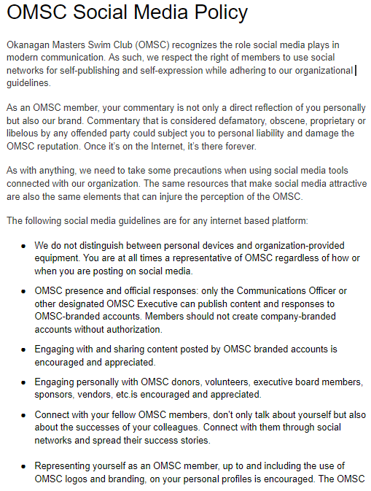
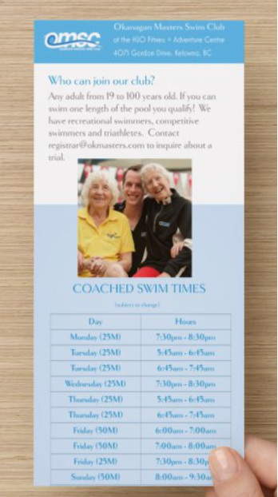
New this year

Slide 25
2018/2019 PLAN:
CONTINUE TO USE MAILCHIMP FOR WEEKLY CLUB COMMUNICATIONS AND ANNOUNCEMENTS, NEWSLETTERS ARE SENT WEEKLY AT MINIMUM
ENSURE ALL SOCIAL EVENTS/STROKE TECHNIQUE CLINICS AND RELEVANT INFORMATION REACHES OUR MEMBERSHIP
INITIATE A STRATEGIC REVIEW OF THE OMSC WEBSITE CONTENT
CONTINUE TO RESPOND TO INQUIRIES BIG AND SMALL WHICH ARE RECEIVED THROUGH COMMUNICATIONS@OKMASTERS.COM

Slide 26
Coaches’ Report (Coach Liaison)
Provincials – OMSC sent 13 swimmers under the care of Stefan as coach. We placed 5th overall with many top 3 finishes and lots of personal bests.
Nationals – OMSC sent 9 swimmers (due the fact Calgary was host city) with Thomas as coach. Everyone either medaled or achieved lifetime best times. The positive results and team spirit in the pool was only surpassed by the comradery outside.
ATLS – While a number of OMSC swimmers were trying ATLS for the first or second time, we also had ten women and seven men in the top 10 in their age groups.
Rattlesnake Island – Eight OMSC members placed in the top 3 in their age groups for the the 3.1km and five placed in the top 3 for the 7km swim.
Cailla Patterson competed in the 2018 Ironman World Championships and place top 25 in her division!

Slide 27
Coaches’ Report (Coach Liaison)
OMSC Coaching Team continues to work successfully without a Head Coach. There is strong communication and support across the team,
Stefan Pripoae revised the Swim Plan created by Emil (in 2017) for 2018/19,
Stefan manages the Stroke Improvement Clinics with the help of Thomas Robinson. They introduced the “classroom” component which has been well received. We ran eight clinics and one mock meet this past year. So far this year, the Turn and Dive clinics were popular,
Thomas continues to set and enter our Relay teams prior to all meets,
We added Roxanna Chavez, Emily Epp to our coaching team this year and had Kassidie Cornell join us for the summer months.

Slide 28
Break

Slide 29
AGM Special Business
Board Motion that Bylaws version 8.3 be registered as a replacement of the existing bylaws for OMSC – Greg Harris
Member Motion to retain the current constitution of OMSC for a further period of no less than thirty-six months – Brent Hobbs

Slide 30
Election of Directors
President – nomination – Sharon Spring
Vice President – nomination – Chris Martin
Treasurer – nomination – Tony Hoft
Director At Large (Social/Volunteer) – nomination – Debra Parker
Director At Large (Coach Liaison) – nomination – Kendra Jacobs

Slide 31
Awards & Appreciation
2018 Most Improved Female
2018 Most Improved Male
2018 Swimmer of the Year
Appreciation

Slide 32
Thank You.

